Slide 1
Normal probability plot
Probability plots can be used to check if a sample came from a particular distribution.
The normal probability plot can be used to check normality.
Example 4.30: 20 observations on dielectric breakdown voltage of a piece of epoxy resin.
> library(Devore7)
> str(xmp04.30)
'data.frame': 20 obs. of 2 variables:
$ Voltage : num 24.5 25.6 26.2 26.4 26.7 ...
$ z.percentile: num -1.96 -1.44 -1.15 -0.93 -0.76 -0.6 -0.45 -0.32 -0.19 -0.06 ...
> qqmath(~Voltage, xmp04.30, aspect=1, type=c("g", "p", "r"))

Slide 2
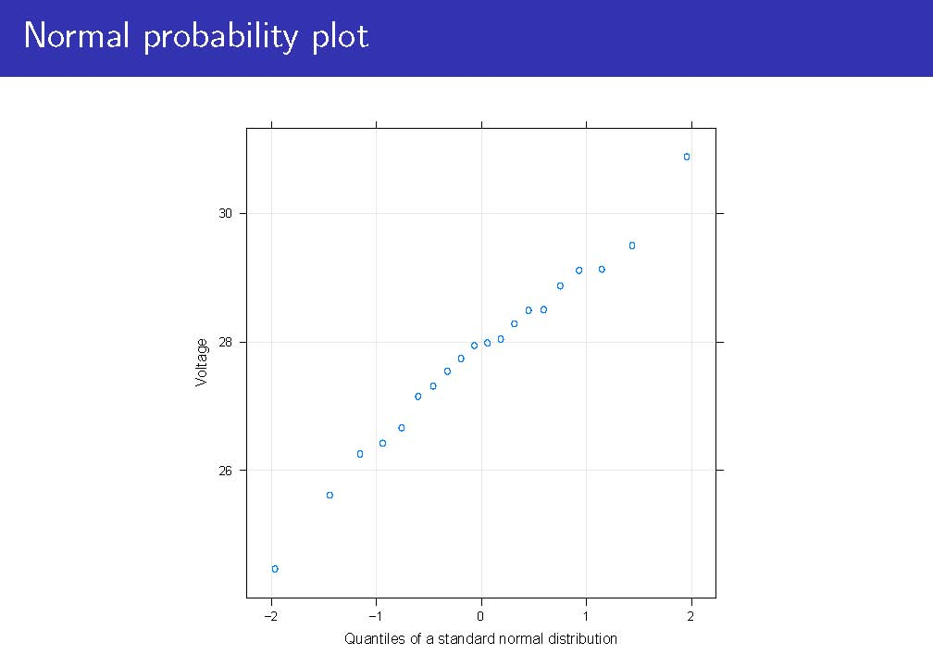

Slide 3
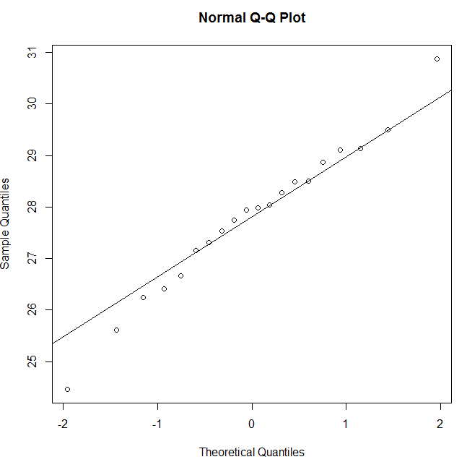
Normal probability plot
library(Devore7)
str(xmp04.30)
qqmath(~Voltage, xmp04.30, aspect=1,
type=c("g", "p"))
# or you can use following command
qqnorm(xmp04.30$Voltage)
qqline(xmp04.30$Voltage)

Slide 4
How to Draw a Normal Probability Plot
Arrange your x-values in ascending order.
Calculate f_{i} = (i-0.375)/(n+0.25), where i is the position of the data value in the ordered list and n is the number of observations.
Find the z-score for each f_{i}
Plot your z-score on the horizontal axis and the corresponding x-values on the vertical axis.
Ex) We have 7 values : 29, 32, 33, 45, 46, 54, 55
1 2 3 4 5
0.1 0.3 0.5 0.7 0.9
 | 29 | 32 | 33 | 45 | 46 | 54 | 55
f | 0.0862 | 0.224 | 0.362 | 0.5 | 0.638 | 0.776 | 0.914
P(Z<z)=f | -1.364 | -0.758 | -0.353 | 0 | 0.353 | 0.758 | 1.364

Slide 5
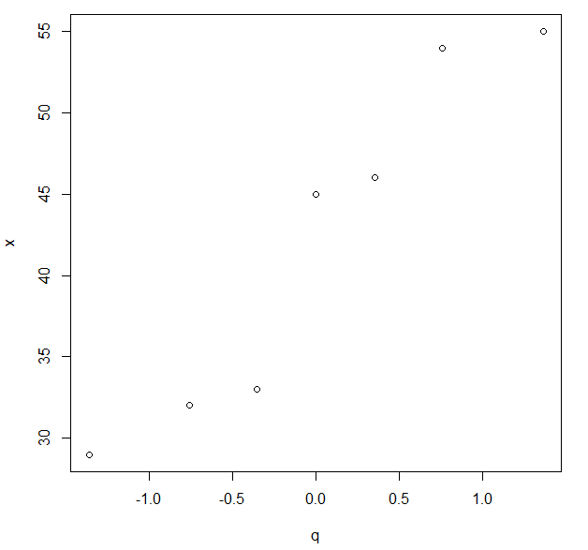
How to Draw a Normal Probability Plot
> x <- c(29, 32, 33, 45, 46, 54, 55)
> qqnorm(x)
> qqline(x)
> f <- (1:length(x) - 0.375)/(length(x)+0.25)
> q <- qnorm(f)
> plot(q, x)

